Slide 1

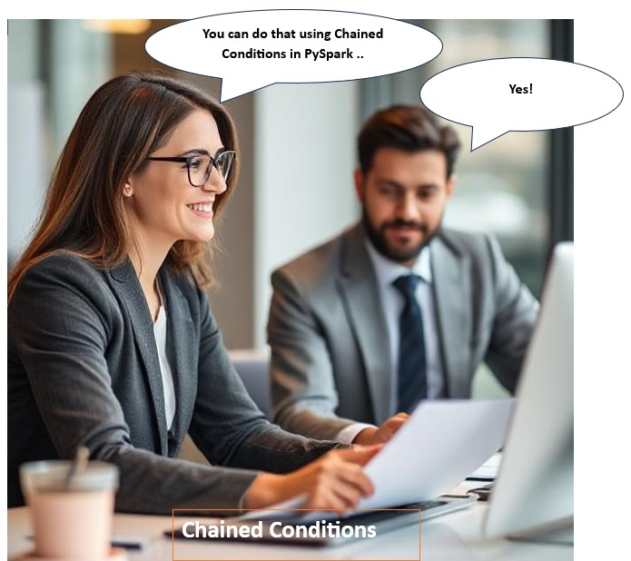
Distributed Computing with PySpark Chained Conditions

Slide 2
Agenda
About Spark
PySpark
Chained Conditions
Why are chained conditions important to know

Slide 3
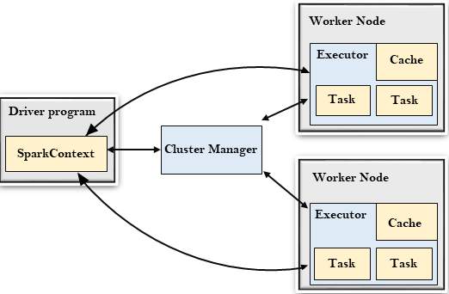
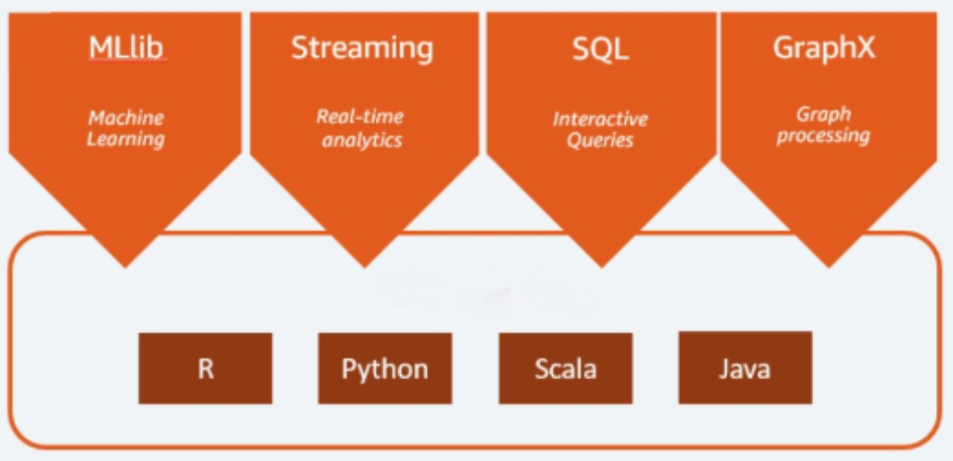
What is Apache Spark
Apache Spark is an open-source distributed cluster-computing framework introduced by Apache Software Foundation.

Slide 4
Introduction to Apache Spark
------------------------------------
A fast and general engine for large-scale data processing
Response to limitations in the Hadoop MapReduce
Implemented in Scala programming language, supports
Java, Scala, Python, R

Slide 5

Pyspark
------------------------------------
PySpark has been released in order to support the collaboration of Apache Spark and Python, it actually is a Python API for Spark.

Slide 6
PySpark - Dataframe
Schema-based: Each column has a name and a data type.
Distributed computing: DataFrames can be processed in parallel across a cluster using Spark’s execution engine.
Lazy Evaluation: Computation is only triggered when an action (i.e.-> .show() or .collect()) is called.

Slide 7
Chained conditions
Chained conditions refer to combining multiple conditions in a single logical statement using logical operators like:
And (both conditions must be true) "&"
Or (at least one condition must be true) "|"
Not (negates the condition) "~"
PySpark use bitwise operators (&, |, ~) instead of Python’s (and, or, not)

Slide 8
Summary
Logical meaning PySpark operator
AND &
OR |
NOT ~

Slide 9
Why is this important
They allow developers to create more precise output by combining multiple criteria. This is essential in real-world problem solving, where decisions often depend on more than one factor.
When your supervisor gives you an Ad hoc task, you can usually find the answer using Chained condition on your dataset.

Slide 10
Supports Advanced Analytics and Insights
Chained conditions enable nuanced analysis, such as:
Classifying customer behavior
Detecting fraud
Prioritizing leads or support tickets
Monitoring service usage patterns

Slide 11
Demo

